Slide 1
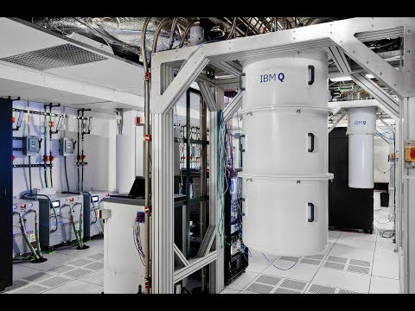

Slide 3
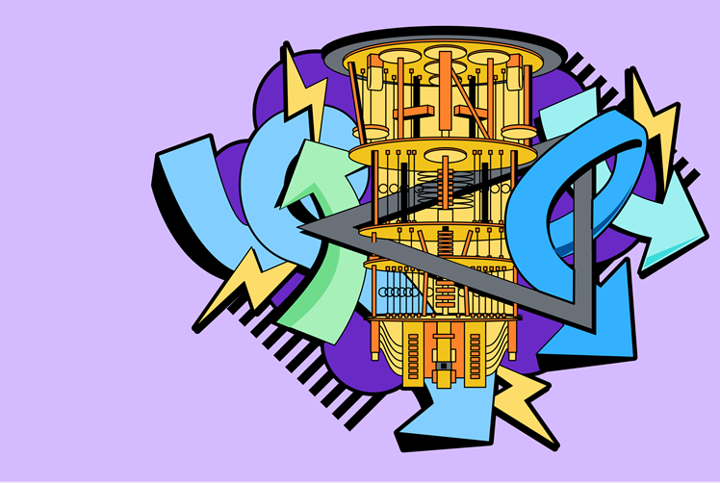
Intro to
Linear Algebra
Vardaan Sahgal
IBM Qiskit Advocate
M.Sc. Physics, NSUT
Notes:
Hi, Hello and welcome everyone. If you attended yesterday’s lecture, you already know me, but in case you are new here today, my name is Vardaan Sahgal and we need to study quantum computing because it has the potential to perfectly simulate a Caffeine molecule, along with some other benefits.
Today’s lecture will be covering an introduction to Linear Algebra. I have tried to keep this lecture as simple as possible and I will be starting from the very basics, but if something still goes over your head, please feel free to ask.

Slide 4
“Understanding quantum is the 2nd most difficult task in the universe!”
- the first still remains approaching your crush ;)
Notes:
Quantum is one of the most difficult and absurd things in the universe… but fortunately we have another equally absurd tool (Math) in our hands which can make our life easier with quantum.

Slide 5
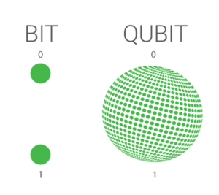
From bits to qubits
Classical states: Bits = 0 or 1
Quantum states: Qubits = superposition of 0 & 1
Notes:
Let us start our today’s lecture with something which we all have already learnt… the fundamental difference between bits and qubits.
Bits exist only in 0 & 1 states, but the qubits can be found in any superposition between 0 and 1.
Superposition allows us to perform calculations on many states at the same time. This helps the quantum algorithms have an advantage over the classical ones.
But one important thing I would like to mention here is something about the measurement. Once we measure the superposition state, it collapses into one of the states. And hence, it is actually very difficult to design algorithms with this fact in mind.

Slide 6
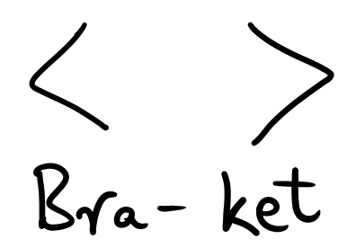
Dirac Notations
Notes:
As I have said, to understand quantum, math is very important… and building on that very fact, I will be introducing a new set of mathematical language to you. This is known as the Dirac notation. The special thing about Dirac notation is that it was developed specifically for quantum mechanics and hence it makes understanding some really weird concepts pretty easy for us!
The first thing we learn in the Dirac notation is the term bracket. You all know bracket right.
On the screen 2 angular brackets are shown… and in this Dirac notation, we call the left angular bracket as BRA and the right angular bracket as KET… together forming a bracket

Slide 7
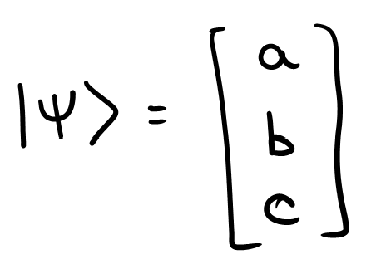
Dirac Notations
Notes:
But mind you, the Dirac maths has just begun, and each term I just defined has a much larger meaning associated with it.
The KET (right angular bracket) is used define any quantum state… or in a simple sense any vector… or in an even simpler sense any column vector as is shown on the screen. Here Psi, a quantum state is represented as a 3 unit column matrix, but this can be extended to any n-tuple vector or any n-unit matrix.

Slide 8
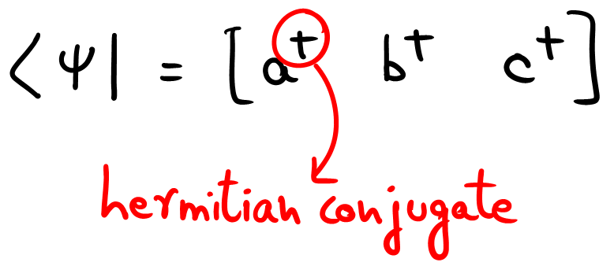
Dirac Notations
Notes:
The other term I talked about is the BRA, or the left angular bracket.
Bra is used to define the

Slide 9
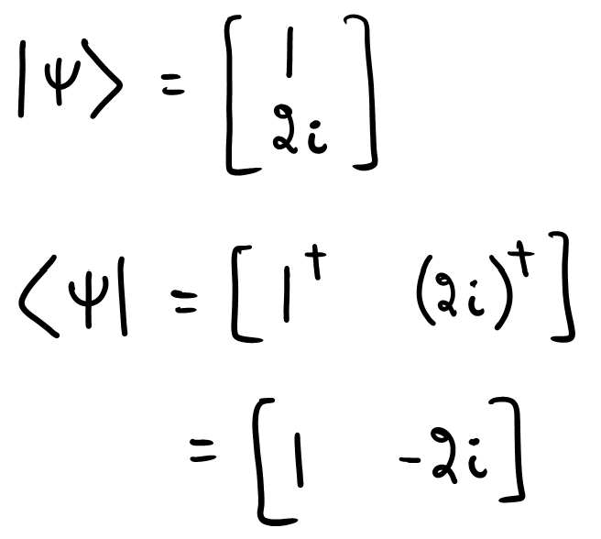
Dirac Notations
Notes:
Let’s start with the scale of quantum computing

Slide 10
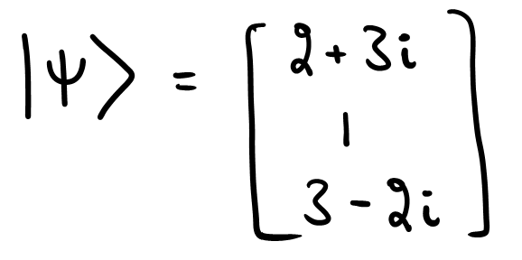
Dirac Notations
Notes:
Let’s start with the scale of quantum computing

Slide 11
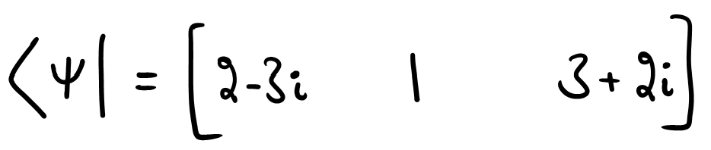
Dirac Notations
Notes:
Let’s start with the scale of quantum computing

Slide 12
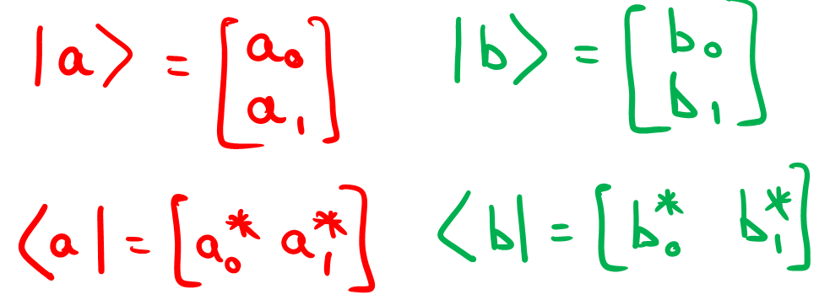
Inner product
Notes:
Let’s start with the scale of quantum computing

Slide 13
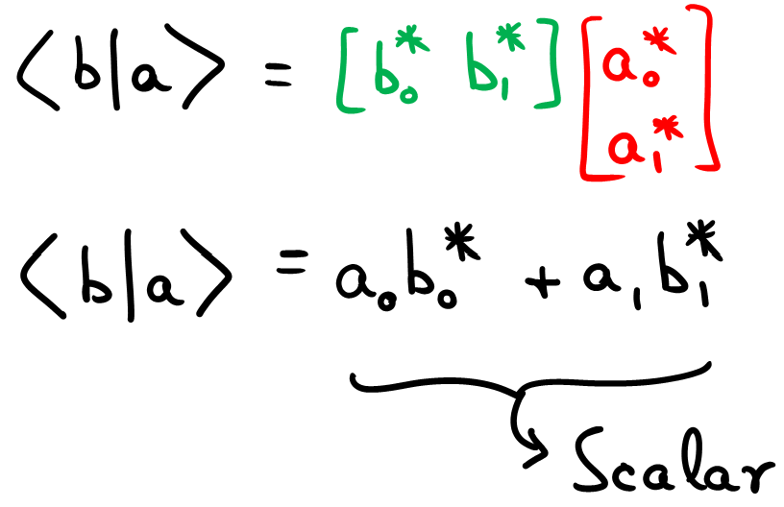
Inner product
Notes:
Let’s start with the scale of quantum computing

Slide 14
Outer product
Notes:
Let’s start with the scale of quantum computing

Slide 15
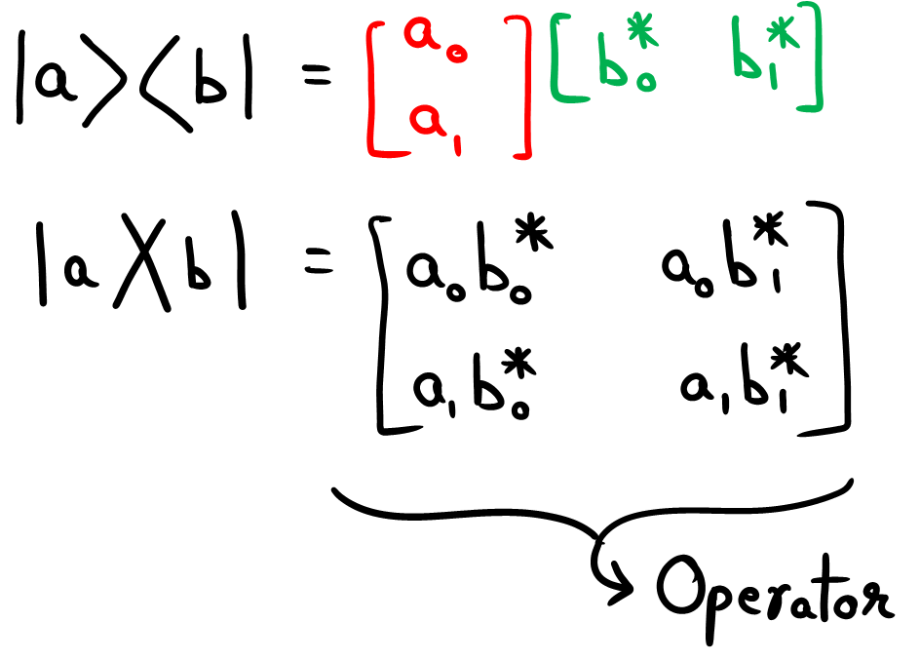
Outer product
Notes:
Let’s start with the scale of quantum computing

Slide 16
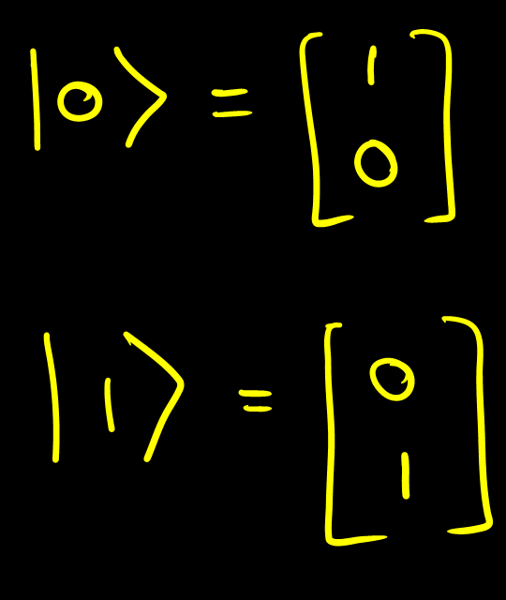
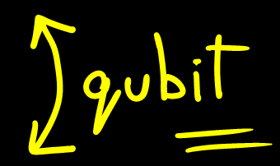

Slide 17
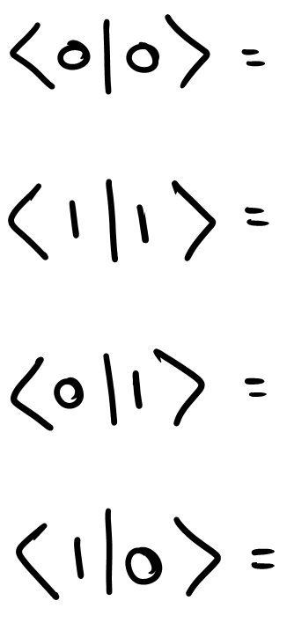
Orthonormal states
Notes:
Let’s start with the scale of quantum computing

Slide 18
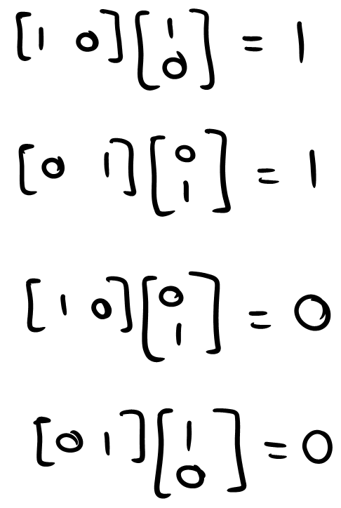
Orthonormal states
Notes:
Let’s start with the scale of quantum computing

Slide 19

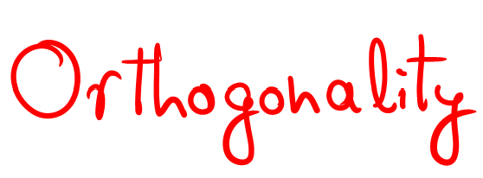
Orthonormal states
Notes:
Let’s start with the scale of quantum computing

Slide 20
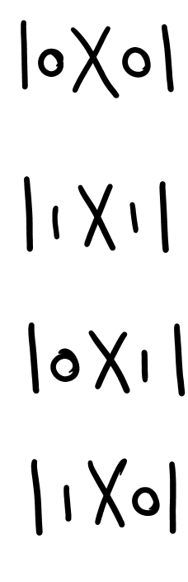
Density matrices
Notes:
Let’s start with the scale of quantum computing

Slide 21
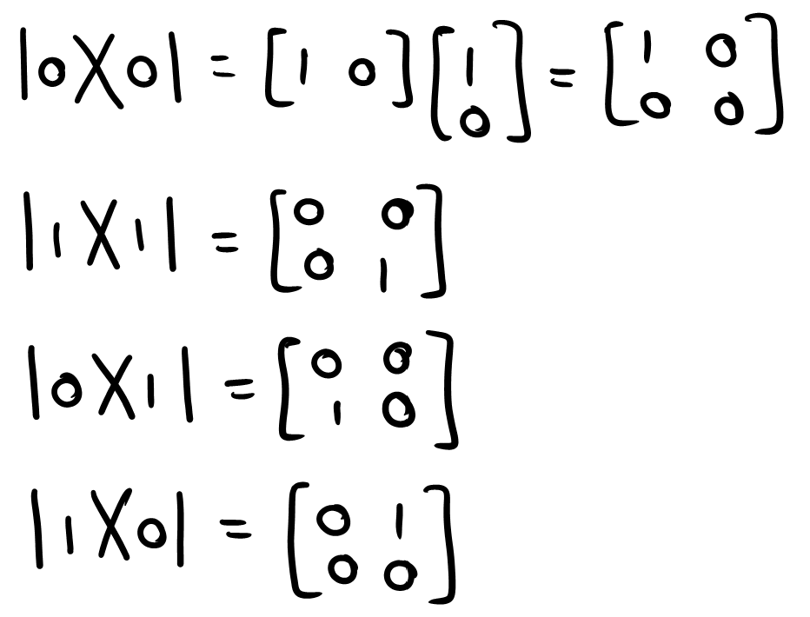
Density matrices
Notes:
Let’s start with the scale of quantum computing

Slide 22
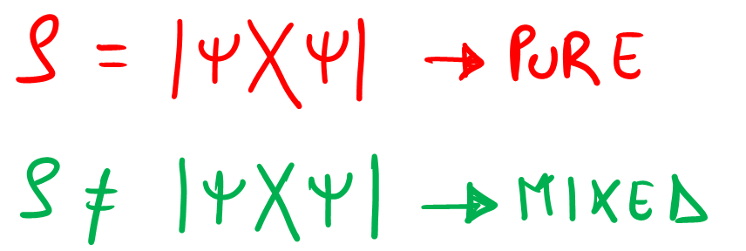
Density matrices
Notes:
Let’s start with the scale of quantum computing

Slide 23
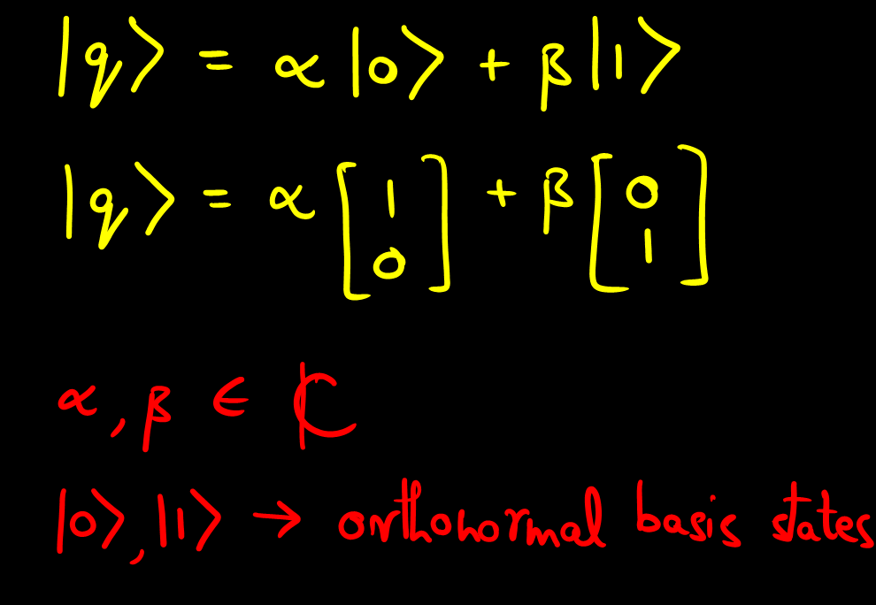
Single Qubit

Slide 24
Single Qubit

Slide 25
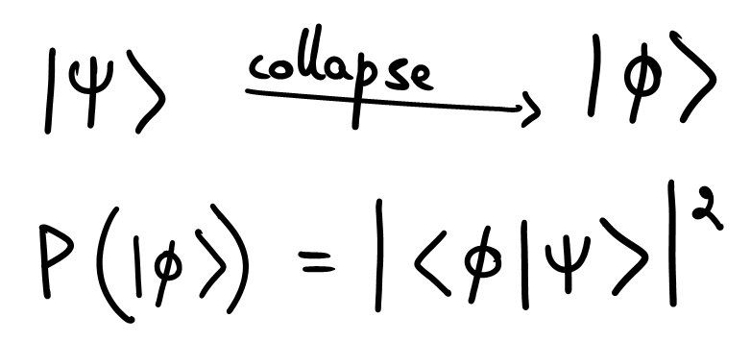
Probability
Notes:
Let’s start with the scale of quantum computing

Slide 26
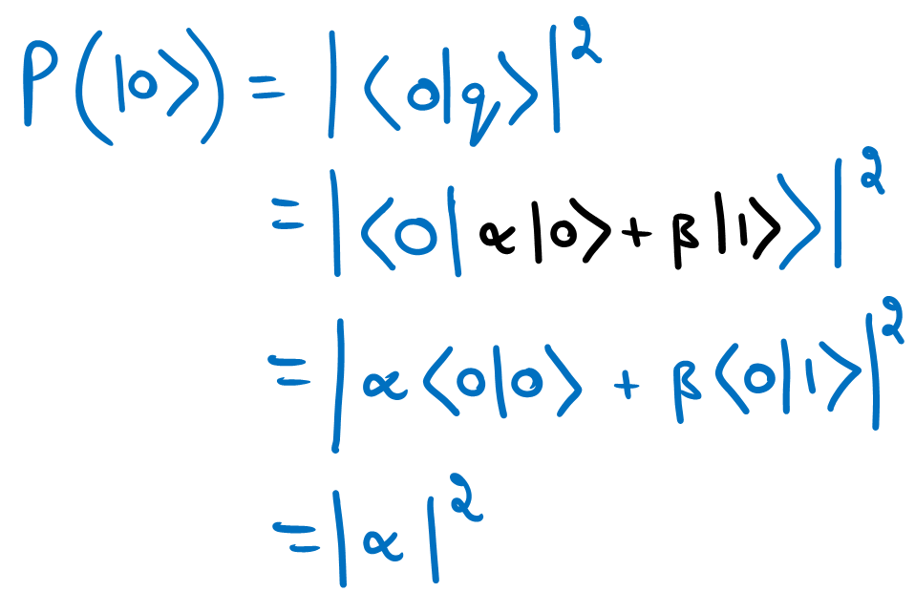
Probability of qubit in |0>
Notes:
Let’s start with the scale of quantum computing

Slide 27
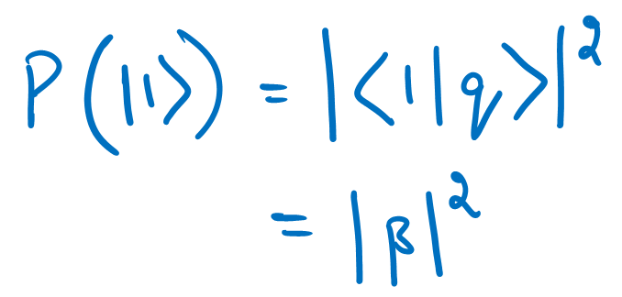
Probability of qubit in |1>
Notes:
Let’s start with the scale of quantum computing

Slide 28
Probability of qubit in |1>
Notes:
Let’s start with the scale of quantum computing

Slide 29
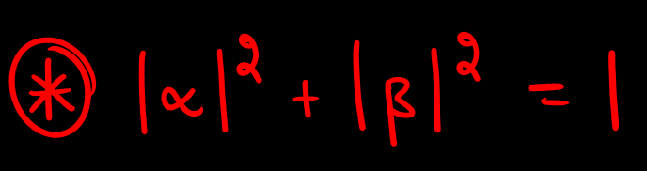
Single Qubit

Slide 30
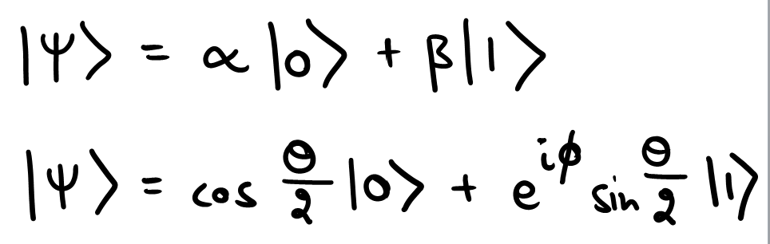
Qubit Representation - Bloch Sphere
Notes:
Let’s start with the scale of quantum computing

Slide 31
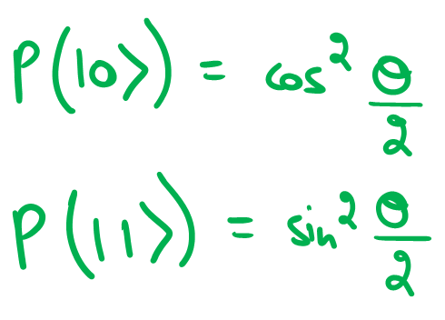
Qubit Representation - Bloch Sphere
Notes:
Let’s start with the scale of quantum computing

Slide 32
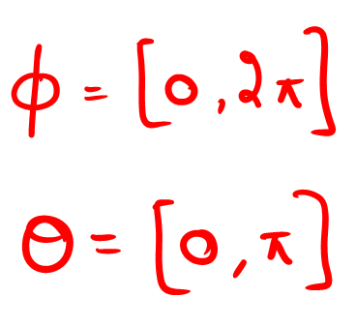
Qubit Representation - Bloch Sphere
Notes:
Let’s start with the scale of quantum computing

Slide 33
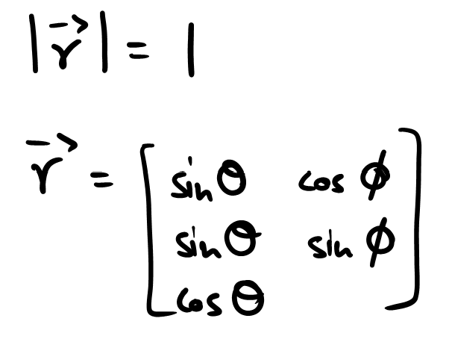
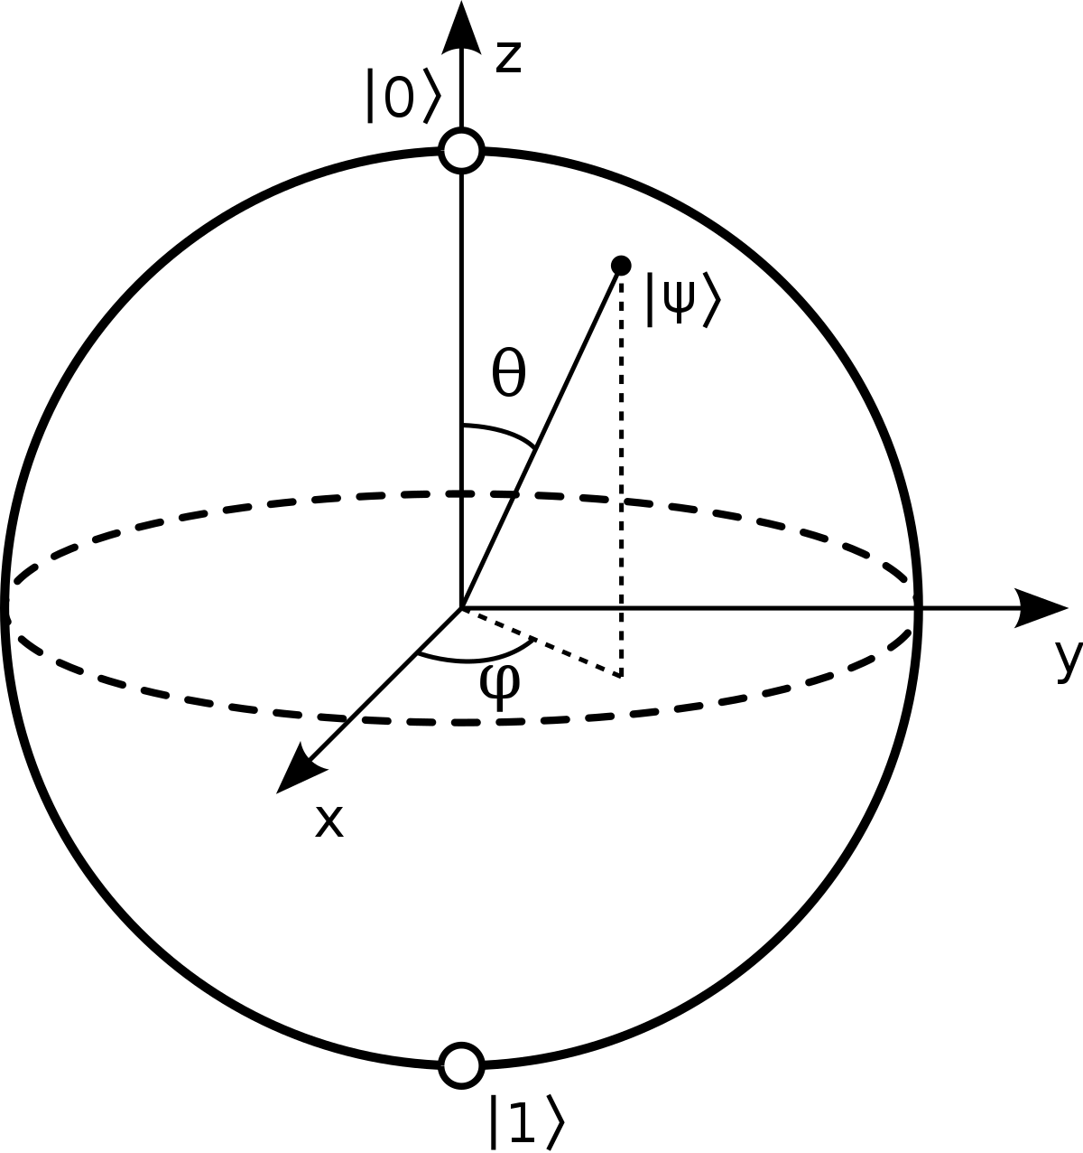
Qubit Representation - Bloch Sphere
All normalised pure states can be illustrated on the surface of a sphere, called as a Bloch Sphere.
Notes:
Let’s start with the scale of quantum computing

Slide 34
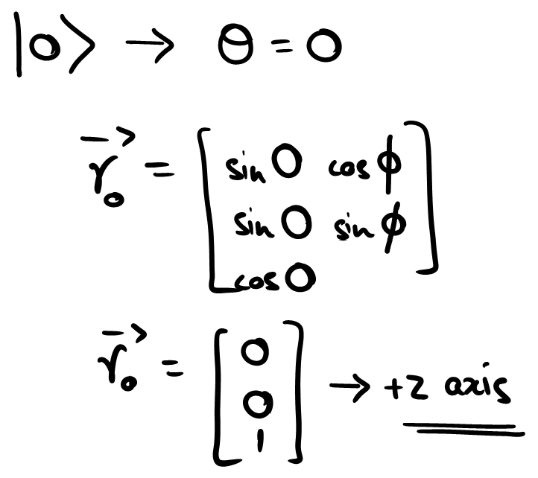
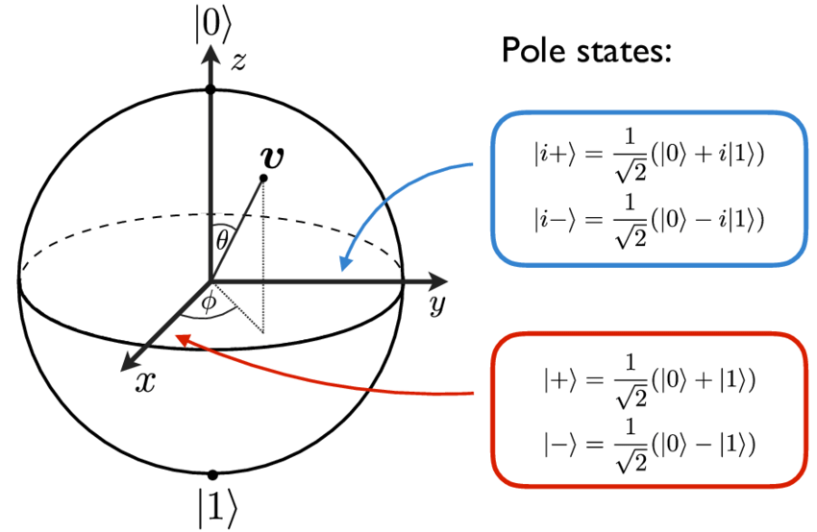
Qubit Representation - Bloch Sphere
Notes:
Let’s start with the scale of quantum computing

Slide 35
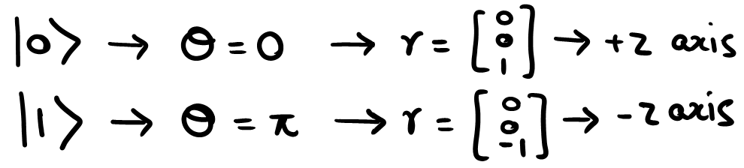
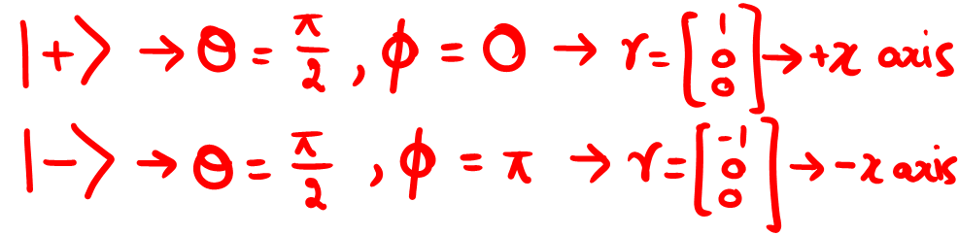
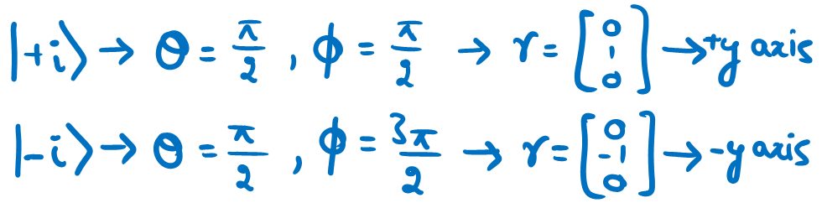
Qubit Representation - Bloch Sphere
Notes:
Let’s start with the scale of quantum computing

Slide 36
Qubits - 2 level quantum systems
Notes:
Let’s start with the scale of quantum computing

Slide 37
Polarisation states of light
Spin ½ particles
Two level atomic states

Slide 38
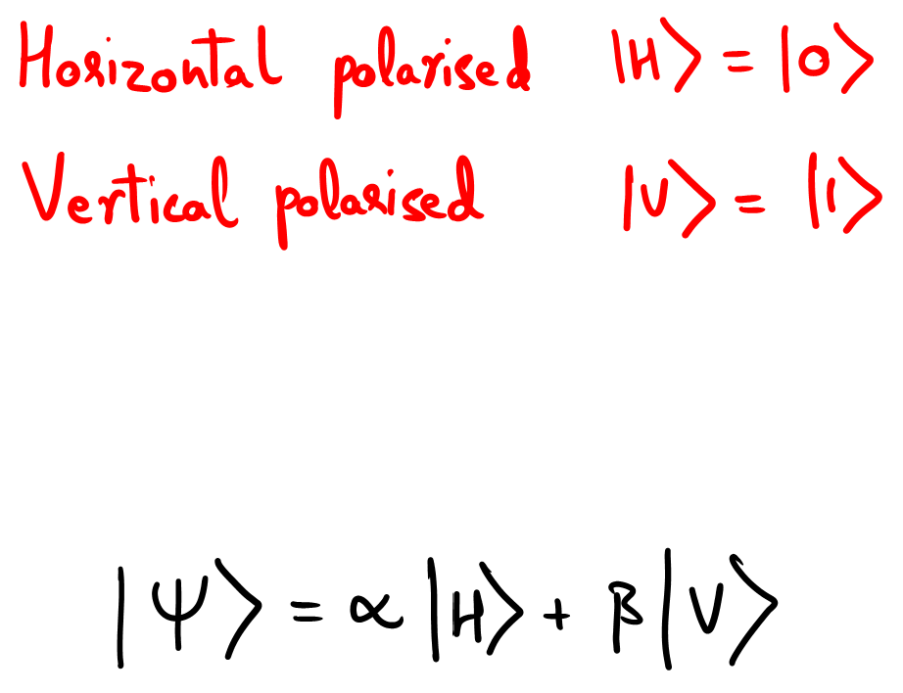
Polarisation states of light
Spin ½ particles
Two level atomic states

Slide 39
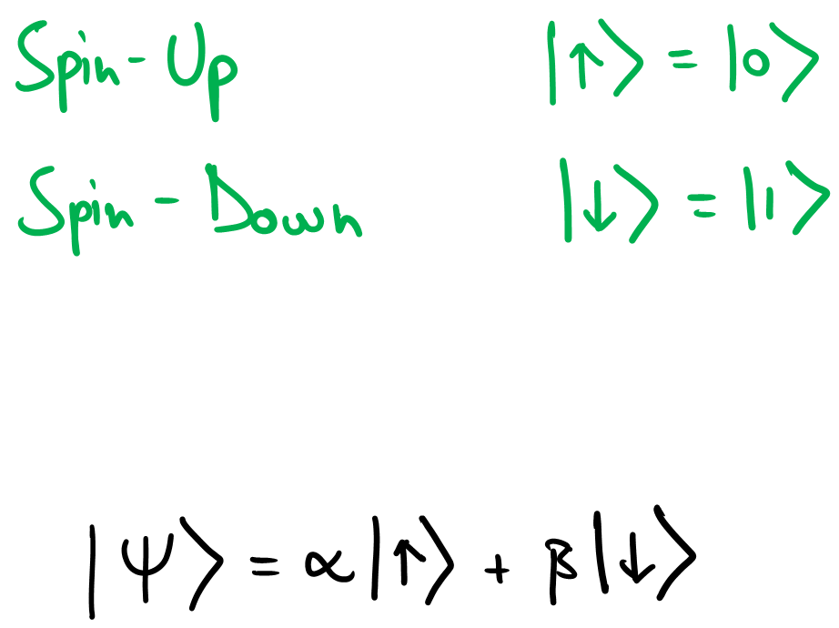
Polarisation states of light
Spin ½ particles
Two level atomic states

Slide 40
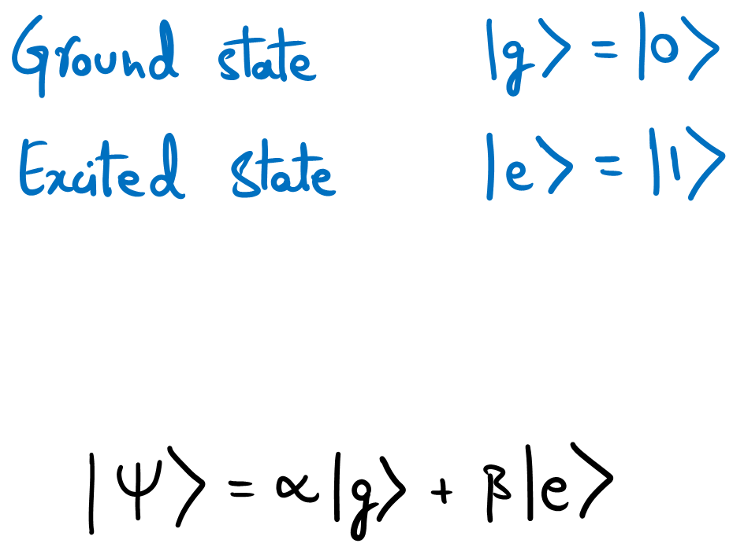
Polarisation states of light
Spin ½ particles
Two level atomic states

Slide 41
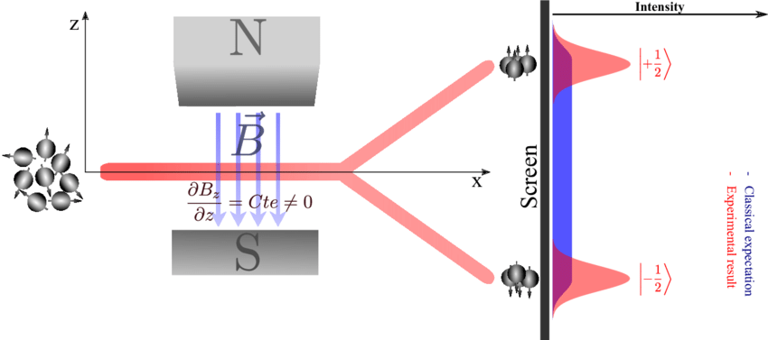
Stern-Gerlach Experiment
Notes:
Now there was an experiment conducted in the 1920s which demonstrated and verified the existence of a naturally occurring 2-level quantum system i.e. the existence of spin in particles.
In this experiment, particles have randomly oriented spin initially. The particles (which are essentially behaving as magnetic dipoles ude to their spin angular momentum) undergo deflection under a non-uniform magnetic field.
Classically, the magnetic dipole moment could be oriented in any direction proportional to the theta
But, on observation, we see exactly 2 possible orientations of the spin angular momentum, corresponding to the 2 bright peaks observed on the screen.
This verifies the existence of a Up and a Down spin or maybe a Positive and a Negative spin of the particles… which as we have just learnt is a quantum 2-level system.
Frankly speaking, there is no need for you all to actually understand this particular experiment, unless ofcourse if you are interested in physics… I just wanted to give you a feel of how the first experiment was conducted in the domain of quantum information science.

